Slide 1
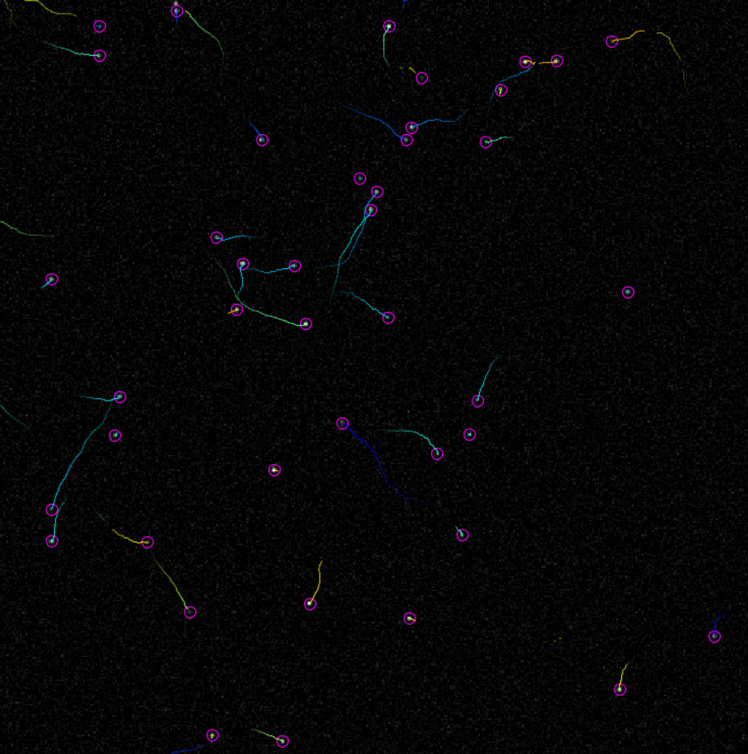
Trajectory Construction
How do we link detections to make tracks?

Slide 2
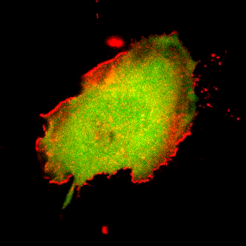
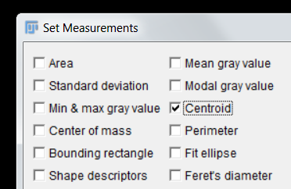

 | X | Y
1 | 54.714 | 52.262
2 | 55.046 | 52.466
3 | 55.197 | 52.539
4 | 55.134 | 52.602
5 | 54.971 | 52.858
6 | 54.894 | 53.022
7 | 54.339 | 53.402
8 | 53.569 | 53.593
9 | 53.22 | 54.242
10 | 53.125 | 54.075

Slide 3
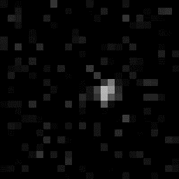

 | X | Y
1 | 14.5 | 12.5
2 | 15.5 | 12.5
3 | 15.5 | 12.5
4 | 13.5 | 12.5
5 | 14.5 | 13.5
6 | 13.5 | 13.5
7 | 14.5 | 13.5
8 | 13.5 | 14.5
9 | 13.5 | 14.5
10 | 14.5 | 14.5

Slide 4
What if you want to track more than one object?
Simplest is nearest neighbour approach
Works for sparse population and high frame rate
t2
t2
t1
t1

Slide 5
Joining the dots
Situation is usually more complicated
t3
t3
t1
t2
t2
t1
t3
t1
t3
t3
t2
t2
t2
t1
t2
t1
t1
t3

Slide 6

Let’s formalise this a little
Need information about particles to construct trajectories:
Minimum amount of info is coordinates:
P1 = (x₁, y₁), P2 = (x₂, y₂)
Think of this as the set of “features”
When constructing trajectories, evaluate differences between features:
$d=\sqrt{{(x_{2}−x_{1})}^{2}+{(y_{2}−y_{1})}^{2}}$
Trajectories are constructed in a way that minimises these differences
P1
t2
P2
t2
P2
t1
P1
t1

Slide 7

building trajectories works like so…
For each particle in frame 1:
For each particle in frame 2:
Compile features for each particle and calculate distance:
$d=\sqrt{{(x_{2}−x_{1})}^{2}+{(y_{2}−y_{1})}^{2}}$
Link particle in frame 2 with lowest value for d.
P1
t2
10
P2
t1
2
P1
t1
P2
t2
3
8
There is usually some “maximum cost” associated with linking

Slide 8
Multiple associations can quickly become computationally challenging
P3
t2
P3
t1
P3
t1
P1
t2
P3
t2
P2
t2
P1
t1
P2
t1
But, can eliminate the least probable links

Slide 9
Demo 5 – Trackmate

Slide 10
Positional Information often insufficient
t3
t3
t2
t1
t1
t3
t2
t3
t1
t3
t2
t2
t2
t1
t2
t1
t1
t3

Slide 11
A Priori information can help in “busy” fields of view
For example, if motion is approximately linear and processive…
t3
t3
t2
t1
t1
t3
t2
t3
t1
t3
t2
t2
t2
t1
t2
t1
t1
t3

Slide 12
“Features” can be anything…
If motion is predictable, we can include “predicted” position as a feature
t1
t3
t1
t3
t2
t2
t3
t3
t3
t2
t3
t1

Slide 13
Complexity can be reduced through choice of imaging conditions
If frame rate is sufficiently high, such that displacement is small relative to object size, tracking becomes trivial
t3
t3
t2
t2
t1
t3
t2
t2
t1
t1
t1
t3
t3
t3
t1
t3
t2
t2
t2
t1
t2
t1
t2
t3
t1
t3
t1
t3
t2
t1

Slide 14
Common Problems
Localisation Error
Influences displacement/velocity measures
All the dots look the same!
Number of available features is small
Motion is often not predictable
Or at least, it is not known beforehand
Missed detections
Breaks in trajectories are commonplace
Need some approach to “bridging gaps”

Slide 15
Despite best efforts, gaps in trajectories will exist!
t4
t1
t4
t3
t2
t3
t2
t3
t1
t2
t1
t4

Slide 16
Most tracking plugins will attempt to bridge gaps.
It may be necessary to adjust either
Detection parameters
Linking parameters
Can introduce spurious detections/links
Errors cannot be eliminated, only minimised.
t4
t4
t3
t3
t2
t2
t1

Slide 17
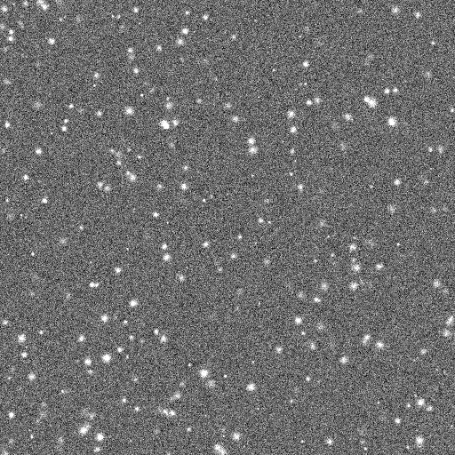
Quiz 4 – Problematic Data set
Open the file in the Quiz 4 folder
4 Points:
List everything that would prevent you tracking the dots accurately (1 point for each)

Slide 18
Challenge 1 – Using TrackMate
Open the Challenge 1 folder – there are two datasets inside.
6 Points:
Track both with TrackMate – which dataset has the higher mean speed?

Slide 19
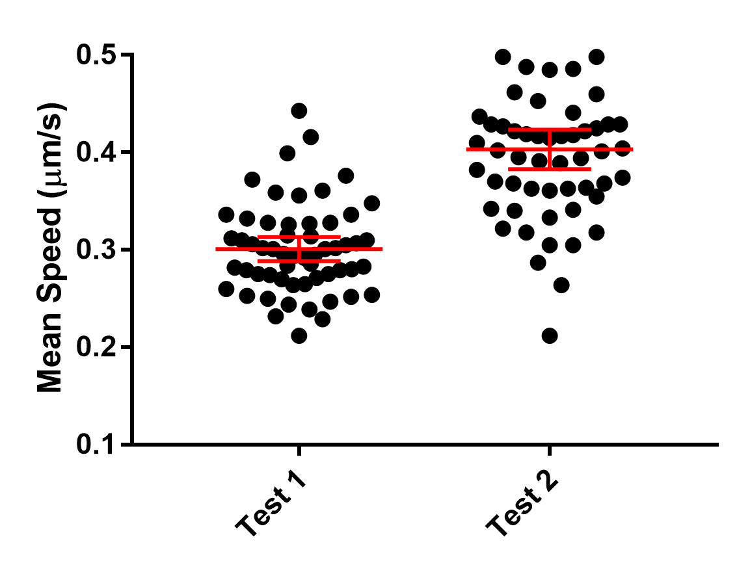

Slide 20
Analysing Trajectories
Once tracked, what numbers can we extract?

Slide 21

Analysing trajectories
t1
Velocity
Instantaneous velocity (v₁, v₂, v₃ … v_{n})
Mean velocity
Directionality
Different definitions
One Example:
Run Length
Velocity may frequently be zero
Intermittent non-zero velocities result in start-stop-start motion
Run length defines distance travelled between “stops”
Mean Square Displacement (MSD)
Δt₁
Δx₁
v₁
t2
Δt₂
Δx₂
v₂
$$\frac{\sum_{i}{\text{Δ}x_{i}} }{Δ\text{X}}$$
ΔT
ΔX
V
t3
Δt₃
Δx₃
v₃
t4

Slide 22
Mean Square Displacement
t2
Δx₂
t5
Δx₁
Δx₂
t3
t1
t4
Δx₃
Δx₄
Δx₁
Δx₁
Characterises nature of motility
Active
Pure Diffusion
Confined

Slide 23
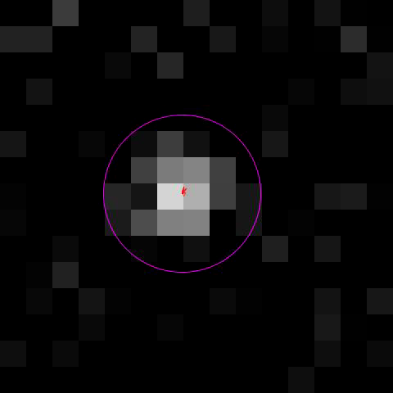
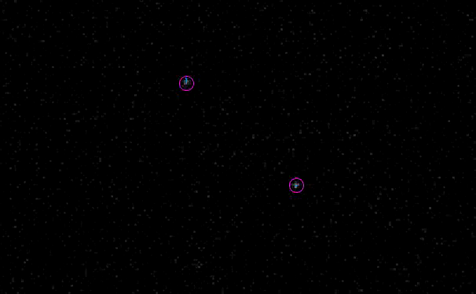
Sources of error
Total displacement
Influenced by localisation error
Stationary particles have non-zero displacement
Velocity
How to deal with “stop-go” motion?
Velocity is rarely zero
Run Length
How to define? What constitutes positive velocity?
Mean Square Displacement
Strongly influenced by noise

Slide 24
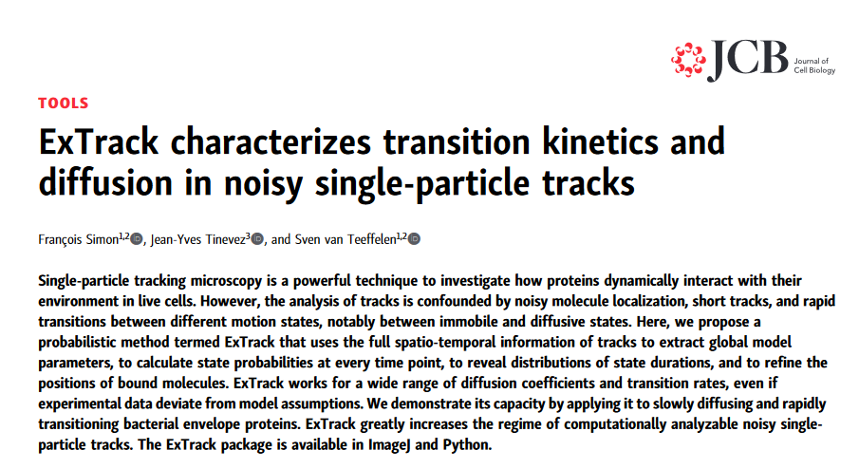

Slide 25
Challenge 2 – Interpreting results
Open the Challenge 2 folder – there are three datasets.
4 Points:
Track all with TrackMate - what is mean speed of the particles in each dataset?
2 Points:
Is mean speed the best metric to show differences between the datasets? Can you think of a better metric?

Slide 26
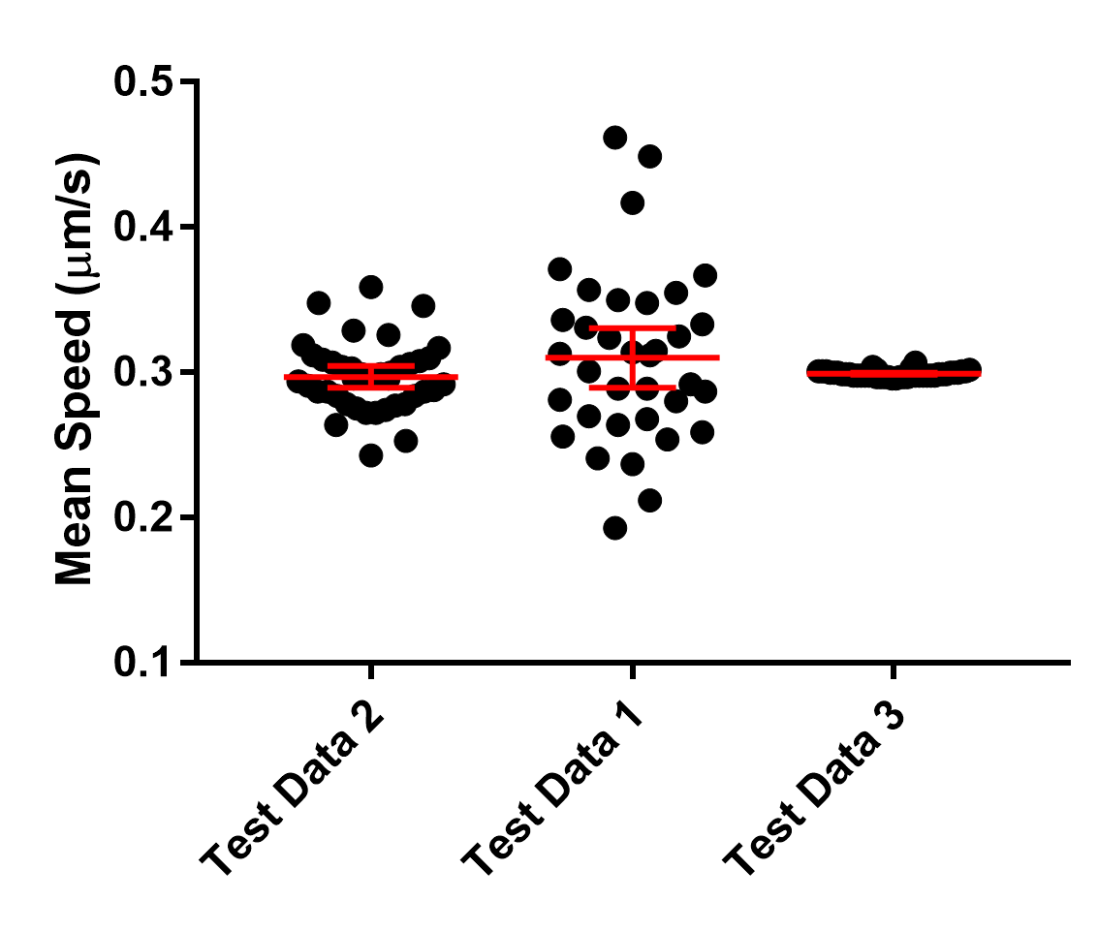

Slide 27



SW302 ● david.barry@crick.ac.uk

Slide 28
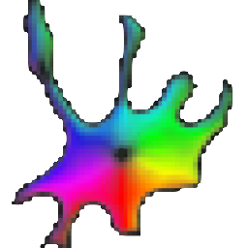
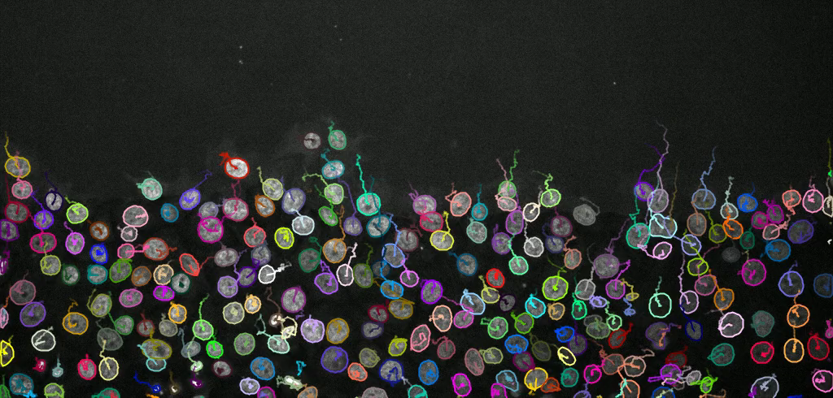

Other methods

